Slide 1


Bill Hoffman
2025/02/02

Slide 2

Outline
Executive Summary
Introduction
Methodology
Results
Conclusion
Appendix

Slide 3
Executive Summary
Publicly available data on SpaceX launch success rate has been acquired and used to form insights into success and risk factors
A combination of Machine Learning and Exploratory Data Analysis by the Space Y Data Science team can provide insights into the prospects for success as the program progresses

Slide 4
Introduction
SPACE Y is developing rockets for the commercial use and wants determine feasibility and profitability to compete in the domain.
SPACE Y wants to develop means to harness publicly available records and use Data Science to predict if SpaceX will be able to reuse rockets in order to inform their own competitive strategies.

Slide 5

Section 1

Slide 6
Methodology
Executive Summary
Data collection methodology:
Data was collected via web scraping and use of API provided by SPACEX
Perform data wrangling
Data was downloaded from SPACEX and Wikipedia sites and processed to address missing values, inconsistent entries and data not useful for this analysis
Perform exploratory data analysis (EDA) using visualization and SQL
Perform interactive visual analytics using Folium and Plotly Dash
Perform predictive analysis using classification models
Several Machine Learning algorithms were applied using train/test split approach and those with best results were employed

Slide 7
Data Collection
Data was collected from SPACEX and Wikipedia sites API/URL
Process involved reading directly from SPACEX URL for structured data (csv)
For Wikipedia data, web scraping was performed to transform web content into structure data

Slide 8




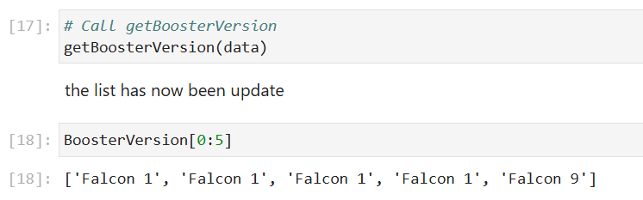
Data Collection – SpaceX API
Data collected using standard python libraries to retrieve data from SpaceX API
Python code and libraries used to clean and transform the data
Example URL showing usage of API to collect data and demonstrate successful retrieval of rocket BoosterVersion data
URL: https://github.com/datanaut314/AppliedDataScienceCapstone/blob/main/jupyter-labs-spacex-data-collection-api-v2.ipynb

Slide 9
Data Collection – Scraping Wikipedia
Webscraping using BeautifulSoup python library to enable retrieval of web formatted data into structured dataframes
https://github.com/datanaut314/AppliedDataScienceCapstone/blob/main/jupyter-labs-webscraping.ipynb
Wikipedia articles with multiple tables per page
parse HTML
Convert to structured dataframes
Store as CSV for later use

Slide 10
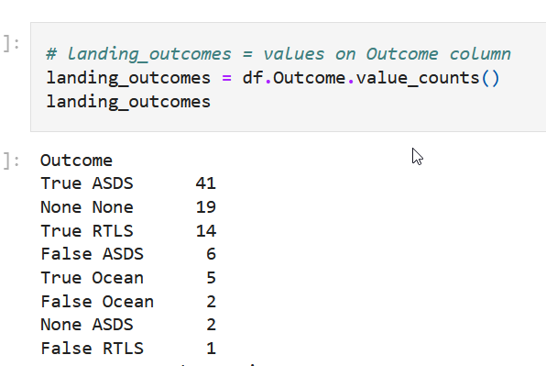
Data Wrangling
Data loaded into jupyter notebooks to facilitate interactive data exploration (EDA)
Data cleaning and preparation performed
https://github.com/datanaut314/AppliedDataScienceCapstone/blob/main/labs-jupyter-spacex-Data%20wrangling-v2.ipynb
Example EDA exploring the types of outcomes and their relative occurrences within the data set

Slide 11
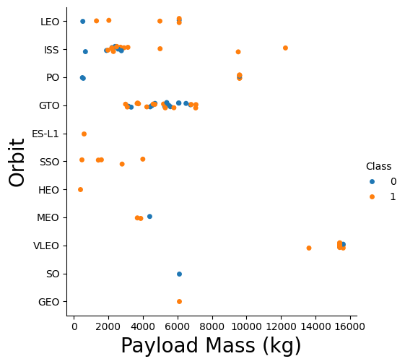
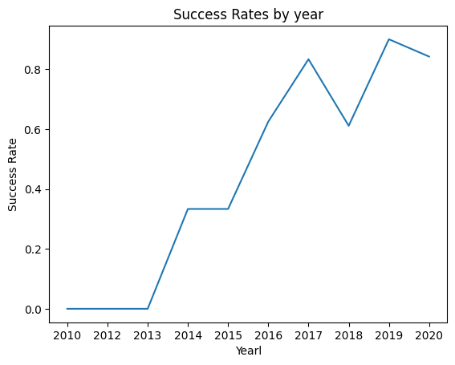
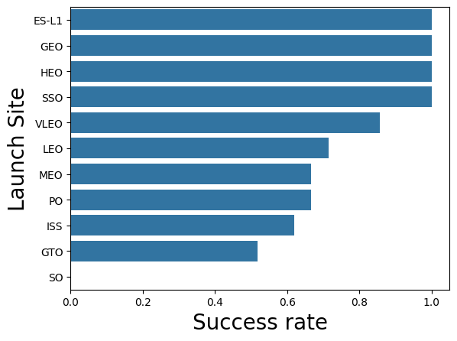
EDA with Data Visualization
It is important to visualize data in various manners to detect trends and patterns and outliers of undue influence
Categorical, Barplot and Time series (line) plots were employed to facilitate inferences from the data
https://github.com/datanaut314/AppliedDataScienceCapstone/blob/main/jupyter-labs-eda-dataviz-v2.ipynb

Slide 12
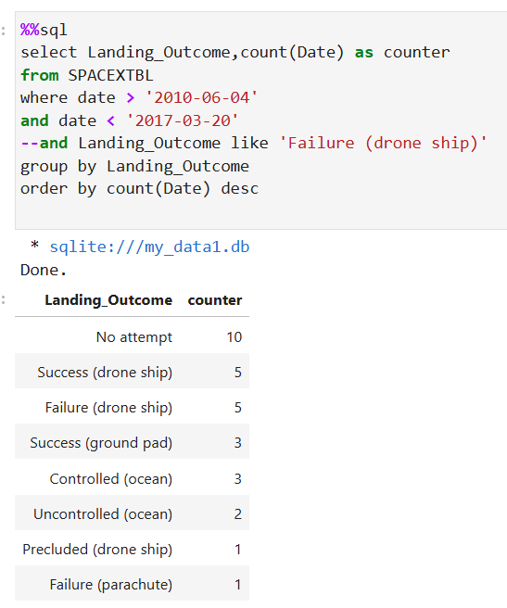
EDA with SQL
A series SQL queries were written which provided the answers to several inquiries about the contents of the data set
Total Payload, earliest successful landing, and subsetting by date ranges are examples of the types of inquiries answered by use of SQL
Example use of SQL to Rank the count of landing outcomes between the date 2010-06-04 and 2017-03-20, in descending order.
https://github.com/datanaut314/AppliedDataScienceCapstone/blob/main/jupyter-labs-eda-sql-coursera_sqllite.ipynb

Slide 13
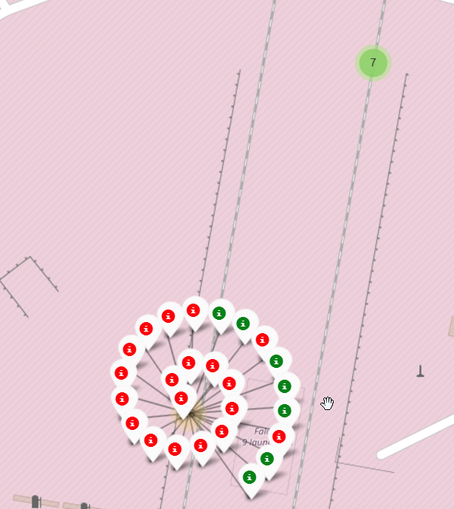
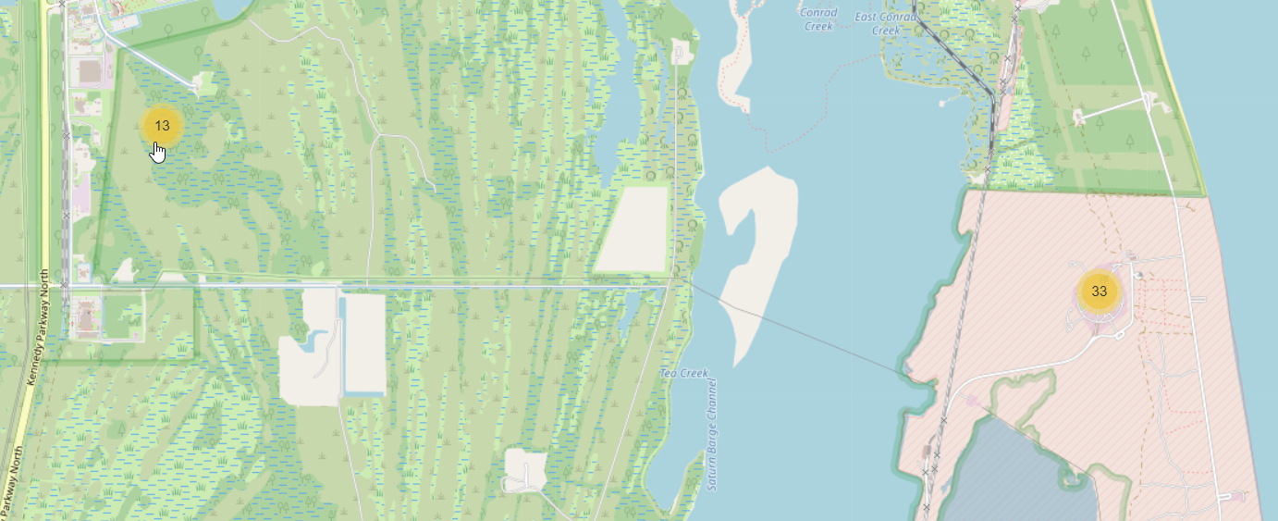
Build an Interactive Map with Folium
Map objects facilitate looking for geographic patterns within the data such as which sites have had fewest successful launch outcomes.
Markers such as circles, lines can be added to enhance the inferences with color coding
addition information such as distances are added to aid insight
https://github.com/datanaut314/AppliedDataScienceCapstone/blob/main/lab-jupyter-launch-site-location-v2.ipynb

Slide 14
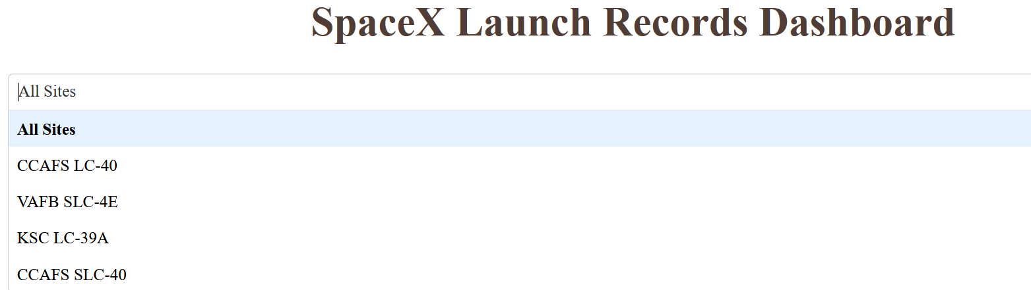
Develop tools for Interactive user exploration of data: Plotly Dash
Plotly Dash was utilized to provide interactive exploration of the data and facilitate end users making inferences from the data
Users are presented with selection options like Launch Sites to allow subsetting of the data for both pie charts and categorical plots of outcome by payload.
User selection of Payload ranges also included to enable exploration of success/failure rates as a function of payload
https://github.com/datanaut314/AppliedDataScienceCapstone/blob/main/spacex_dash_app.py

Slide 15
Predictive Analysis (Classification)
Data was split into Training and Test (20%) segments and models developed
Using GridSearch techniques, best performing parameters were selected for each of the following Classification models:
LogisticRegression
SVM
DecisionTree
K Nearest Neighbor (KNN)
For each, a grid of parameters were used to provide options to search for best performing prediction
https://github.com/datanaut314/AppliedDataScienceCapstone/blob/main/SpaceX-Machine-Learning-Prediction-Part-5-v1.ipynb

Slide 16
Results
The following slides show:
Exploratory data analysis results
Interactive analytics demo in screenshots
Predictive analysis results

Slide 17

Section 2

Slide 18
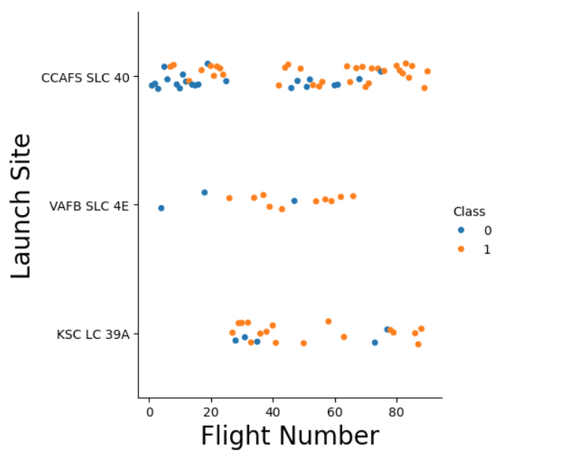
Flight Number vs. Launch Site
scatter plot of Flight Number vs. Launch Site
This view of the data depicts the progression of success/fails spread across the 3 Launch sites
It can be inferred that Cape Canaveral site had more of early flights and thus a higher rate of failures during that early timeframe
All sites had higher success rates as flight number increased overall

Slide 19
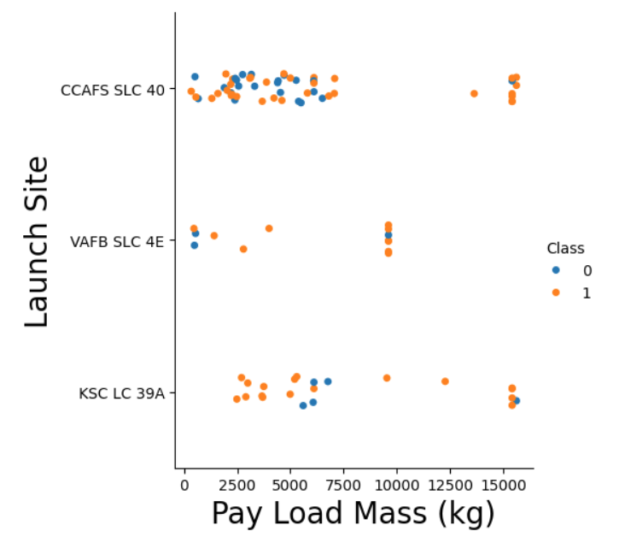
Payload vs. Launch Site
scatter plot of Payload vs. Launch Site
No strong inferences regarding payload and success rates
VAFB has not had any launches above 10k KG

Slide 20
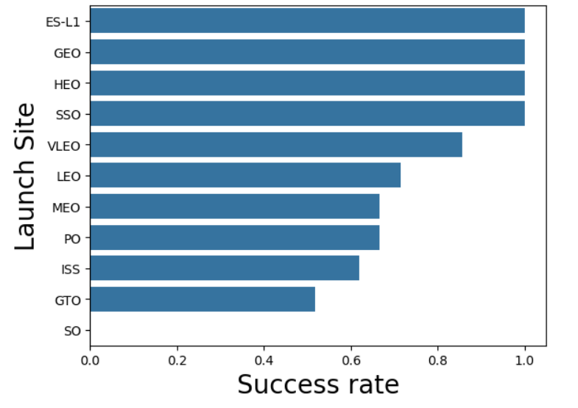
Success Rate vs. Orbit Type
bar chart for the success rate of each orbit type
Top4 all 100%
GTO near 51% of its 27 launches
SO 1 fail in 1 attempt

Slide 21
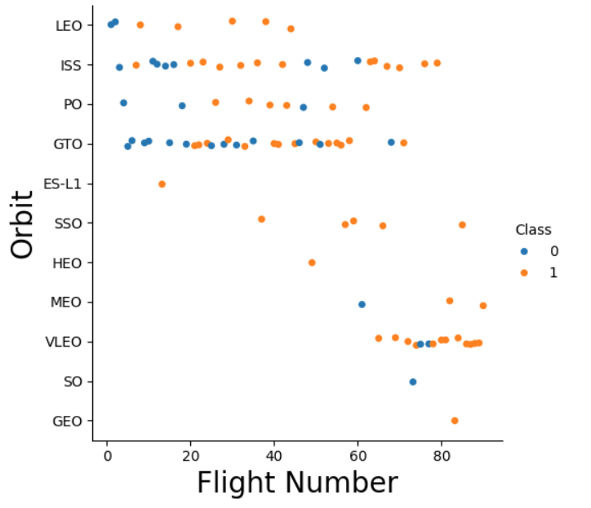
Flight Number vs. Orbit Type
scatter point of Flight number vs. Orbit type
LEO, VLEO, PO show apparent “learning rate” as success becomes more common as flight number increases
GTO notably shows routine success/fail mix over time
Sites with only later starts show higher success rate implying learning rates across Orbit types

Slide 22
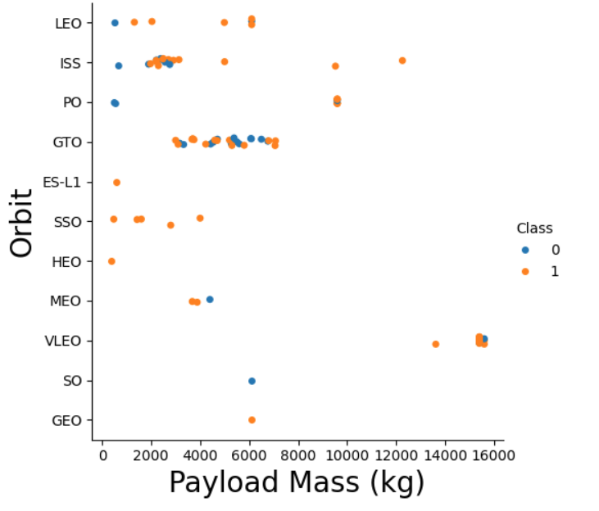
Payload vs. Orbit Type
scatter point of payload vs. orbit type
heavy payloads successful landing or positive landing rate are more for Polar, LEO and ISS.
However for GTO we cannot distinguish this well as both positive landing rate and negative landing (unsuccessful mission) are both there here.

Slide 23

Launch Success Yearly Trend
line chart of yearly average success rate
General trend of increased success rates
Exception of 2018 timeframe

Slide 24
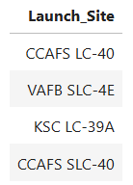
All Launch Site Names
Find the names of the unique launch sites
Distinct set of site names via SQL query:

Slide 25
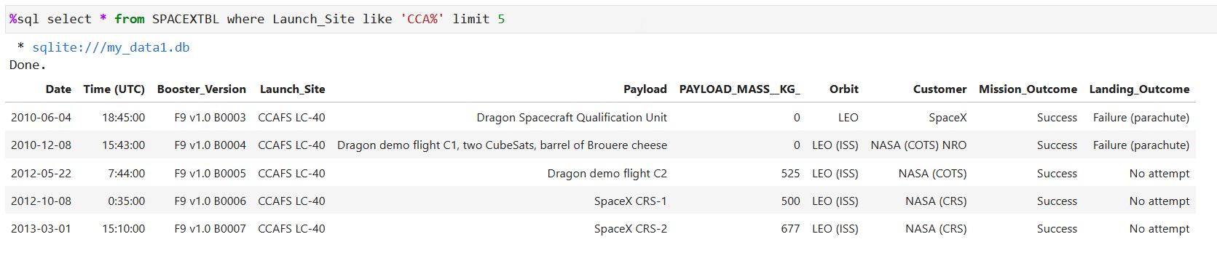
Launch Site Names Begin with 'CCA'
Find 5 records where launch sites begin with `CCA`
Output showing results of query differing date, boosters, orbits, customers and Landing outcomes all from sites at CCA

Slide 26
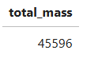
Total Payload Mass
Using SQL, Calculate the total payload carried by boosters from NASA as the sum of all payloads from all missions where NASA was the customer

Slide 27
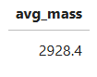
Average Payload Mass by F9 v1.1
Calculate the average payload mass carried by booster version F9 v1.1
Using SQL avg function for all data for this booster version

Slide 28
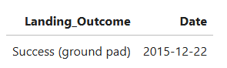
First Successful Ground Landing Date
Find the dates of the first successful landing outcome on ground pad
Used SQL functions of ordering and limit to select just the earliest record with Successful landing on ground pad

Slide 29
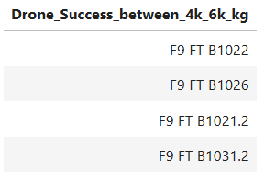
Successful Drone Ship Landing with Payload between 4000 and 6000
List the names of boosters which have successfully landed on drone ship and had payload mass greater than 4000 but less than 6000
Compound criteria of Success on Drone Ship and payload mass between range endpoints

Slide 30
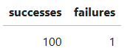
Total Number of Successful and Failure Mission Outcomes
Calculate the total number of successful and failure mission outcomes
By categorizing rows as success or failure and summing the count an overall summary is achieved

Slide 31
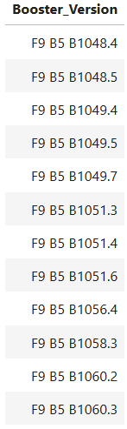
Boosters Carried Maximum Payload
List the names of the booster which have carried the maximum payload mass
By first selecting the Max payload, we are able to determine which Booster Versions have been used in support of those missions

Slide 32
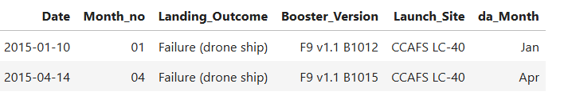
2015 Launch Records
List the failed landing_outcomes in drone ship, their booster versions, and launch site names for in year 2015
SQLite does not natively support decoding month number to names, but using some techniques we are able to product both month number and names

Slide 33
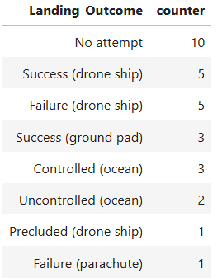
Rank Landing Outcomes Between 2010-06-04 and 2017-03-20
Rank the count of landing outcomes (such as Failure (drone ship) or Success (ground pad)) between the date 2010-06-04 and 2017-03-20, in descending order
SQL has robust means to select only rows meeting the desired criteria
And also to perform summarization in this case by grouping by outcome and counting the instances of each

Slide 34

Section 3

Slide 35
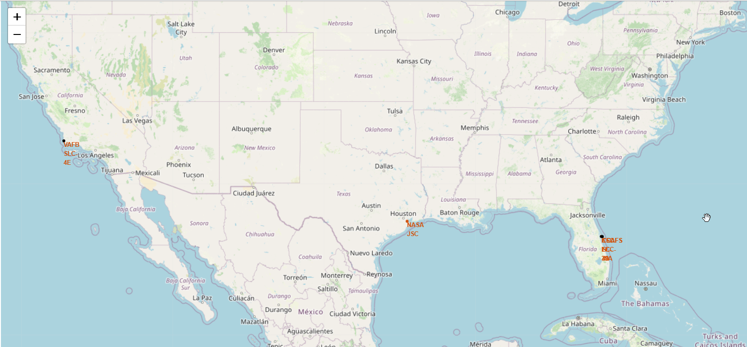
Launch Location Map
Sites for California and Florida launch sites as well and NASA central in TX shown on map

Slide 36
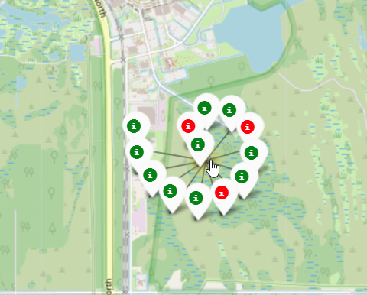
Success/Failure rate by Launch site on Map
By use of colored markers, it becomes each to explore the success rate of all launch sites

Slide 37
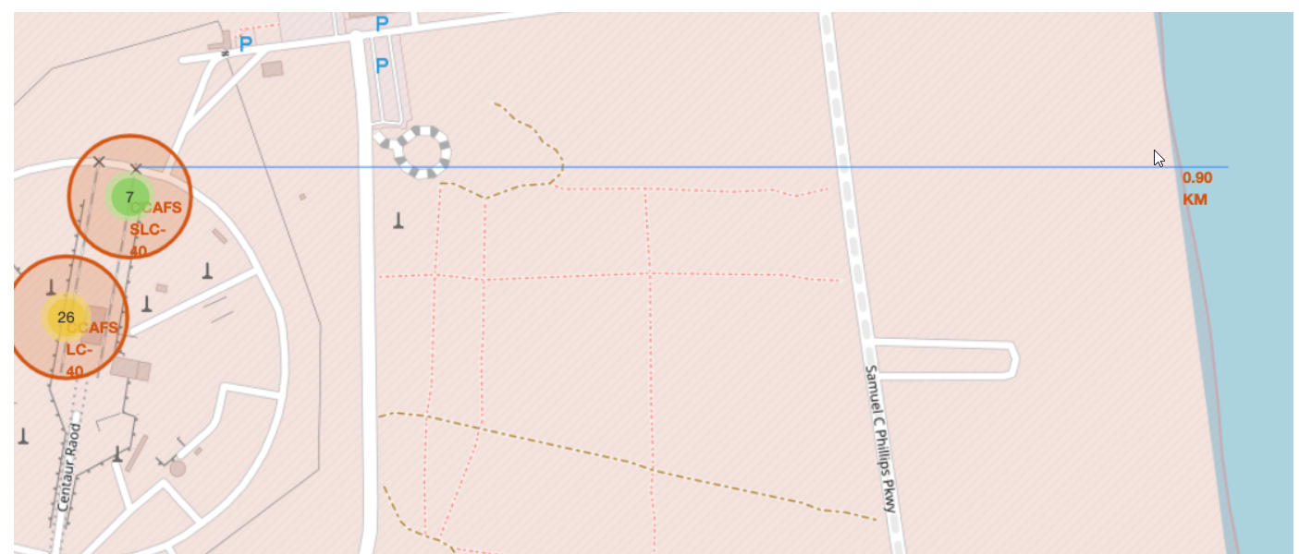
Geographic discovery
By use of geographic information, proximity to various locations can be displayed and calculated
This example shows determining the distance from a launch site to the nearest coast line, shown as 0.90 KM using the lat/long of each endpoint

Slide 38

Section 4

Slide 39
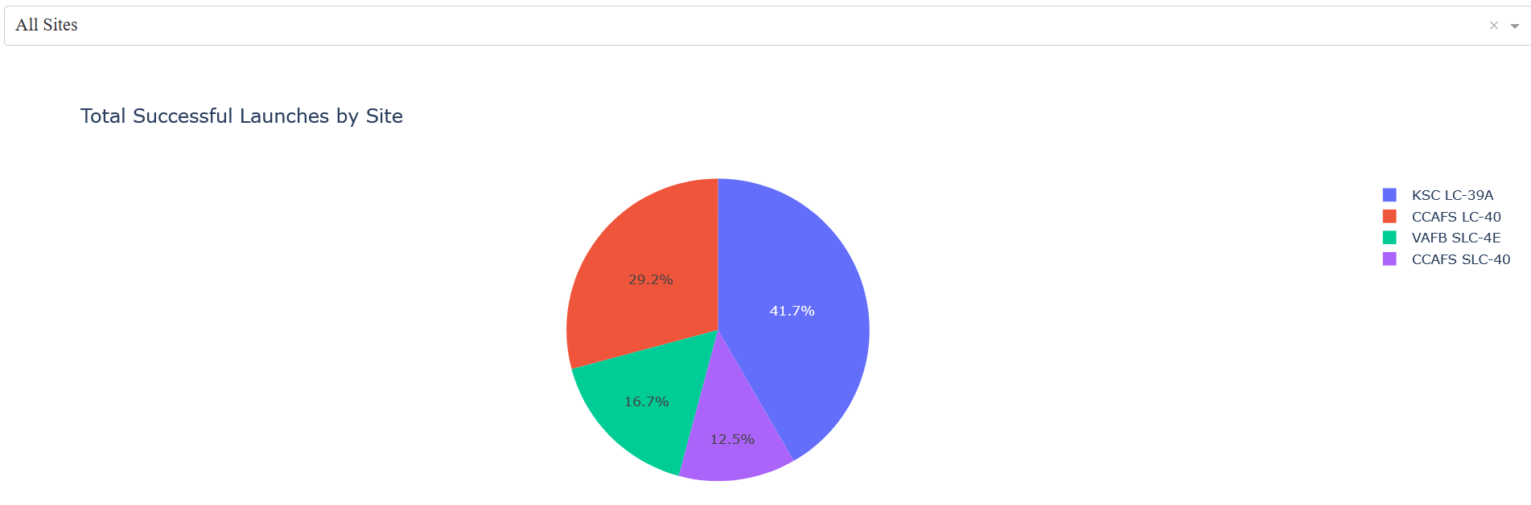
Interactive Dashboard – user-driven data exploration
This example shows the ability to compare proportions by category
In this case, successful launch counts by site
Proportion values shown in pie slice
Each Site a unique color in the chart

Slide 40
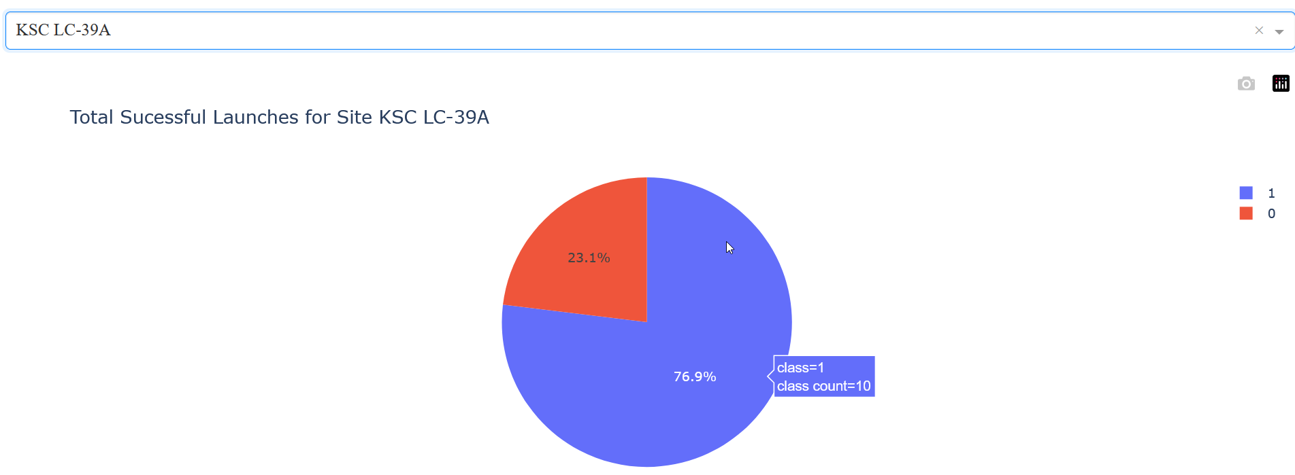
KSC LC-39A: site with highest success rate
This site has had 10 of 13 launches successful

Slide 41
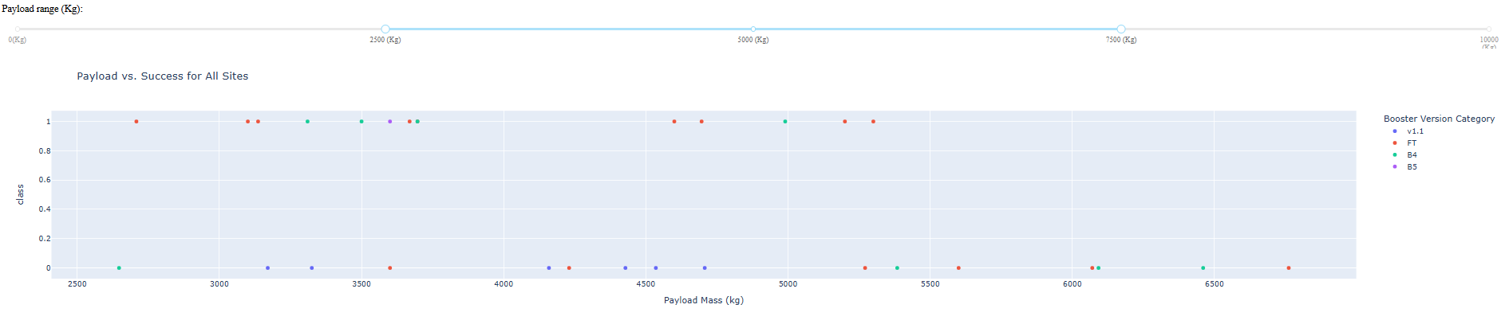
Relationship between Payload and success by Booster Version
Slider allows exploration of relationship of Success within ranges of Payloads
One can find optimum ranges for each class to maximize ROI for customer payload and most likely successful Booster choices

Slide 42

Section 5

Slide 43
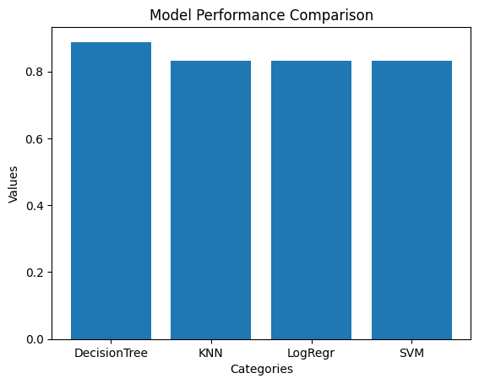
Classification Accuracy
Given the input data set and 20% test/train split (rand state = 2), each model provided above 80% score
DecisionTree scored best at .888
The other 3 scored .833

Slide 44
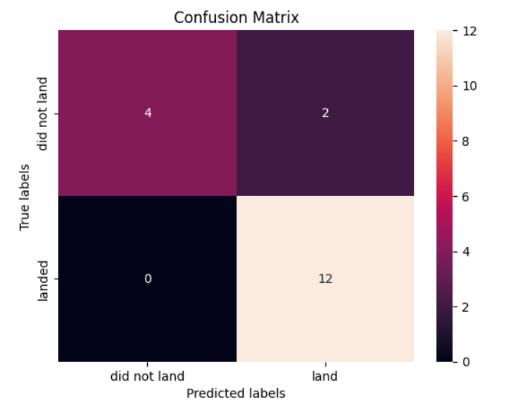
Confusion Matrix
DecisionTree model performed slightly better than other models with the given input data for test/train sets (and requested random state of 2 for test reproducibility)
Confusion matrix of this model indicate high rate of True Positive predictions at 12/12

Slide 45
Conclusions
This prototype demonstrates that sufficient PUBLIC information is available to draw inferences about SpaceX success rates which can be used in competitive analysis for Space Y
Trend of improve success rates over increased launches as well as increased payload sizes over time point to need to plan for learning by Space Y team
There will likely be early failures but they are part of the path to success
Exploration of multiple relationships with data set including geographic, correlations between variables and time series allow for robust inferences which Space Y can harness to increase its learning rates
ML modeling can provide reasonable assessment of odd of success of future missions

Slide 46
Appendix
All project source files can be found at:
https://github.com/datanaut314/AppliedDataScienceCapstone

Slide 47


